Slide 1
X-section ABN-ABS
See Cross section locations.kmz & Cross section labels.kmz for location in Google Earth

Slide 2
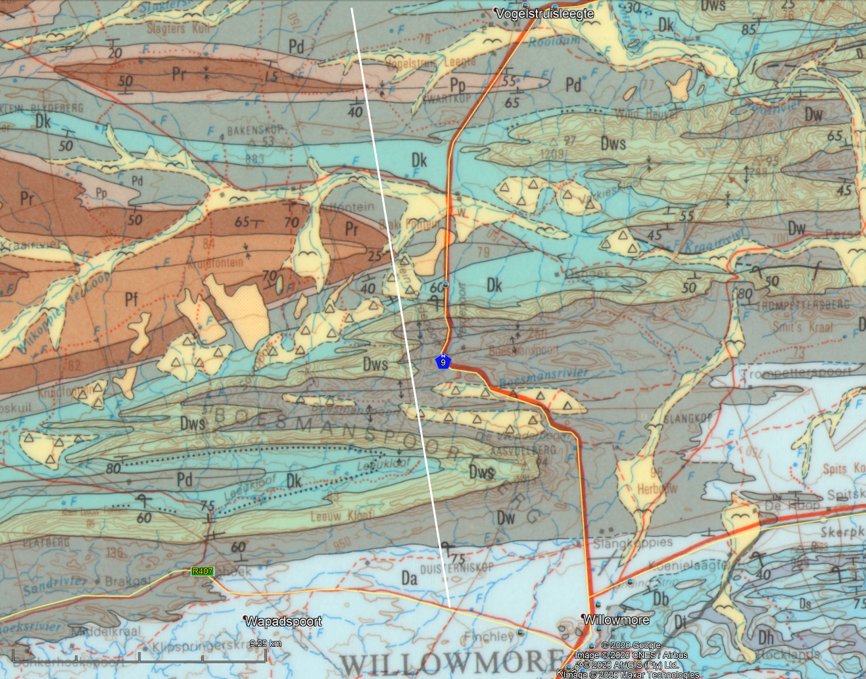

ABN
Aasvoëlberg
ABS

Slide 3
Schematic Geologic Cross Section ABN-ABS
Map symbols from Council for Geoscience 1:250 000 Geology Map 3322 Oudtshoorn
Prepared for CREW weekend 7 – 8 November 2020
masl
Boesmanspoortberg Anticlinorium
Aasvoëlberg Syncline
1 500
1 000
Dk
Dws
Pr
Pr
Dw
Pp
Pp
Pd
Pd
Dk
500
Dk
Dws
Dw
Undifferentiated Bokkeveld and older CSG units
Dws
Dw
0
5
10
15
20
km
ABN
ABS

